Slide 1
“Crossing Boundaries Between Cities and Disciplines”
Bernard J. Brommel Research Talk
Scott Hegerty, Economics
October 15, 2025

Slide 2
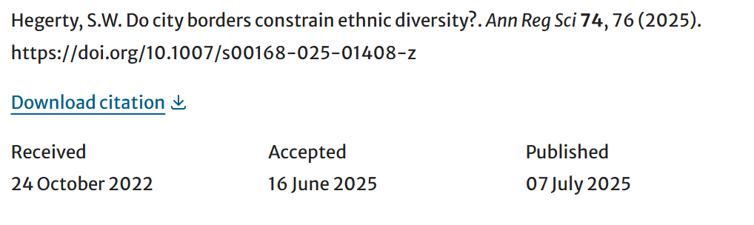
Following a Research Project
Started: 11/2018
Conferences: MCRSA 6/2019 (withdrawn); MEA 3/2020 (canceled!); IEA 10/2021
Journal Rejections: Urban Studies 5/2020, Urban Affairs Review 6/2020
Posted on ArXiV 5/2021
Resurrected 2/2022 (Journal of Economics and Management) …

Slide 3
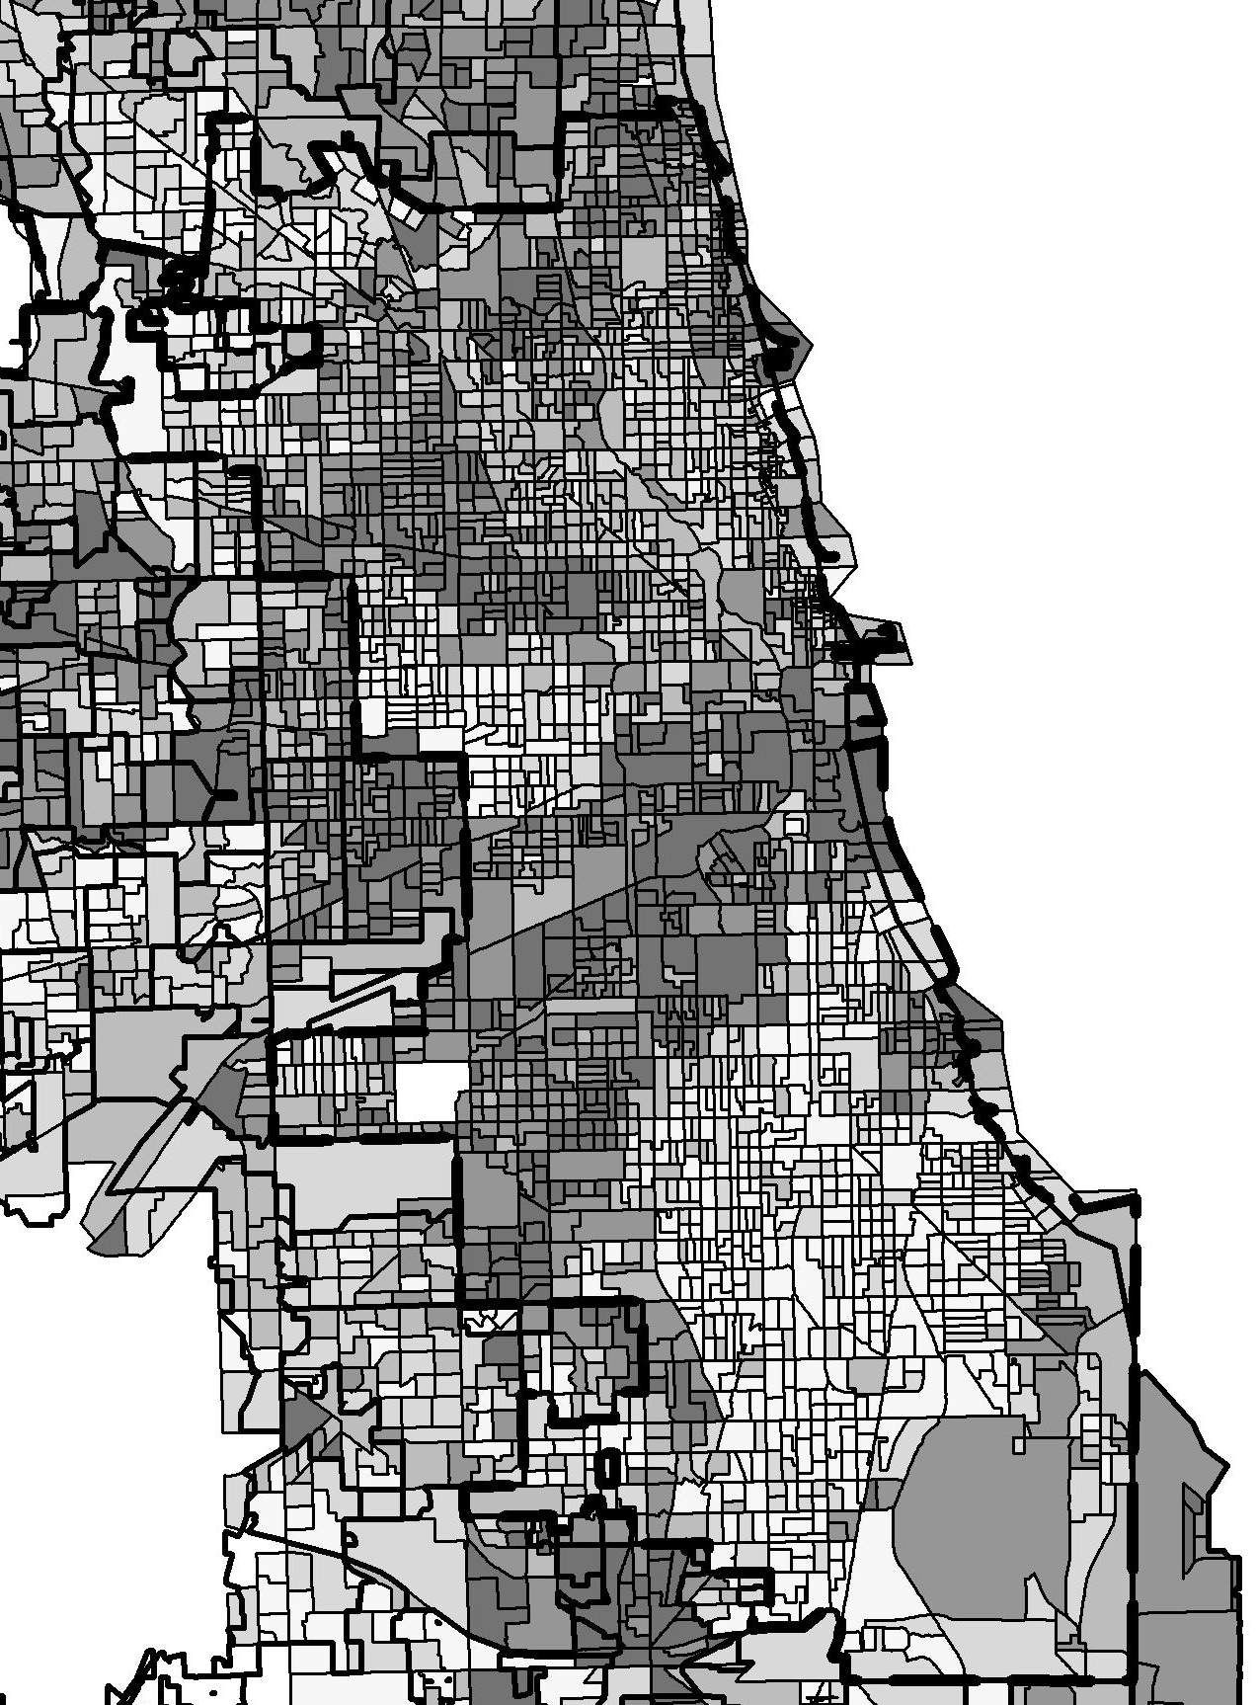
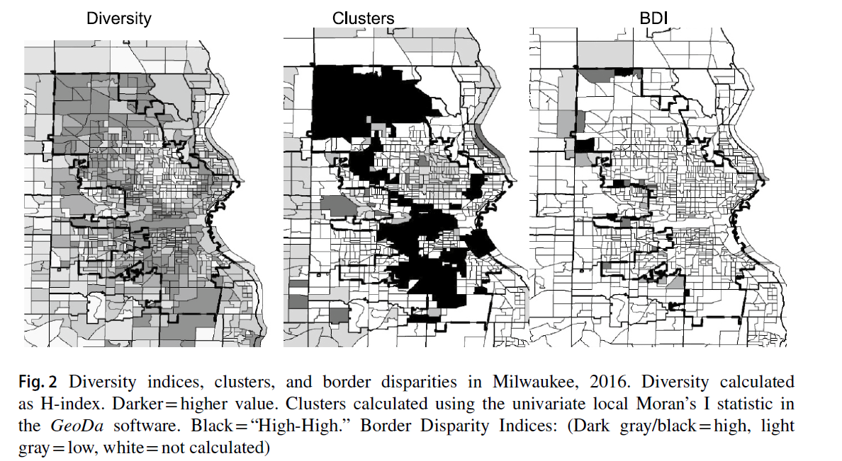
Idea: Ethnic Diversity in Milwaukee and Chicago
(Darker = higher diversity)

Slide 4
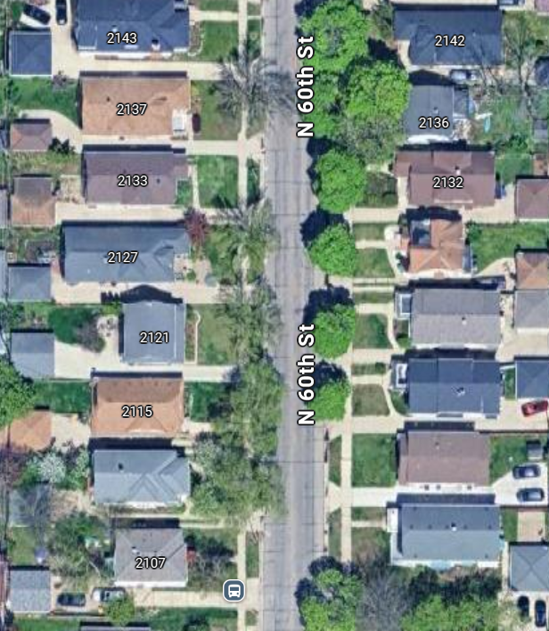
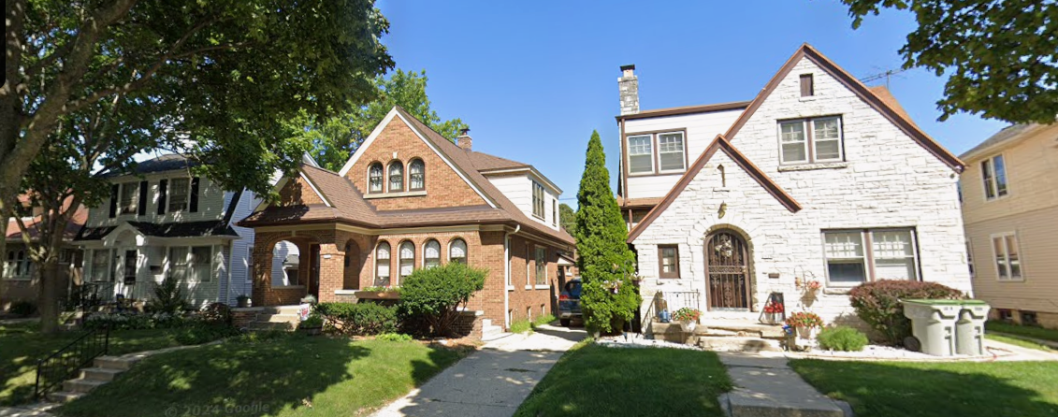
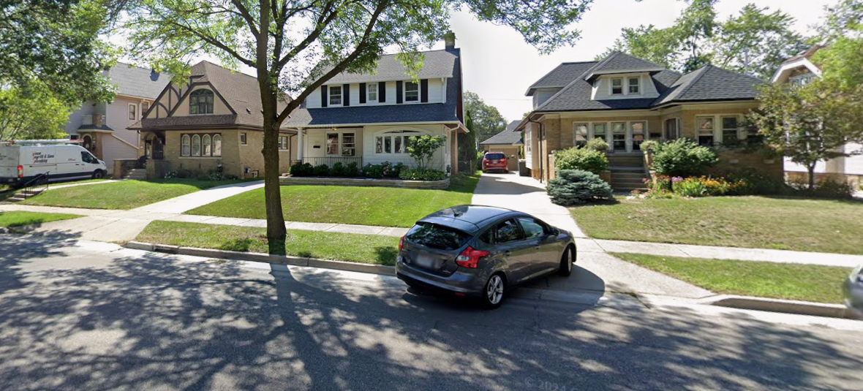
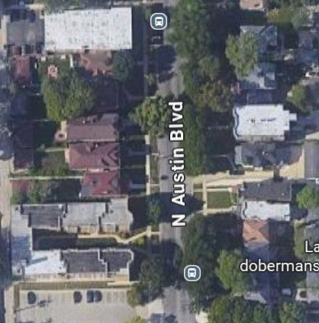
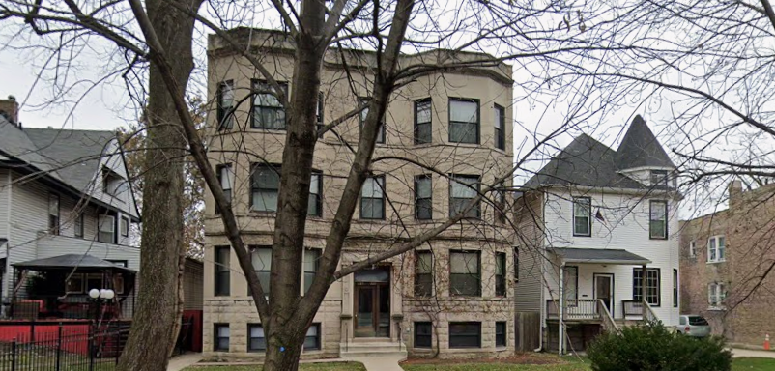
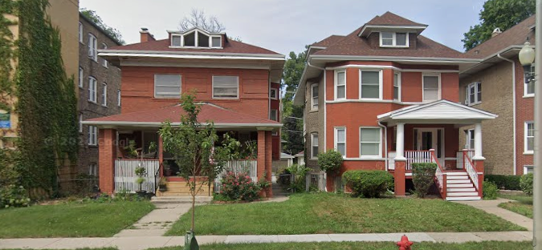
Which is Milwaukee/which is Wauwatosa?
Which is Chicago/which is Oak Park?

Slide 5
Little physical difference across city borders
But in some cases, the diversity level changes drastically
Can only tell with some sort of data
Need a way to test and evaluate
Follow the process from idea to presentation

Slide 6
1. Developing the Idea
Why isn’t observation enough?
What approaches can you choose, and why?
Background knowledge + literature + methods
Crossing disciplines: Geography/Economics/Math/History/Politics/Psychology …

Slide 7
2. Formulating Clear Questions
Does neighborhood diversity change sharply at city/suburban borders?
In which U.S. metro areas does this happen most?
Which specific suburbs have the biggest disparities?
What might be the causes of this?

Slide 8
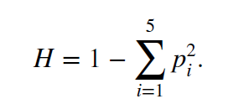
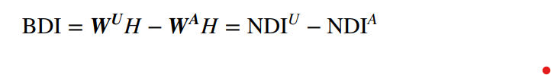
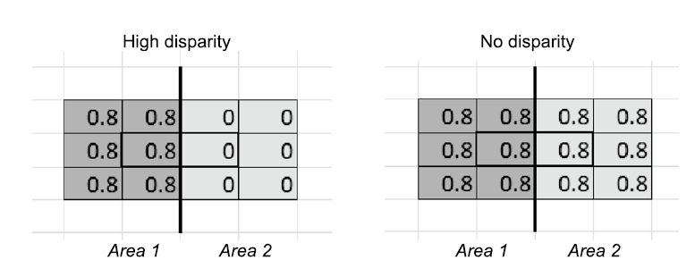
3. Finding an Approach
Modified from Chakravorty (1996) “Neighborhood Disparity Index”
Census 2012-2016 5-year estimates for block groups
25 U.S. Cities (> 250K pop., must have straight land borders w/suburbs)
Herfindahl-Hirschmann Index of industry concentration: Diversity Index
Literature across disciplines + new ideas
If no disparity, both averages are 0.8
Difference is 0.0
Unadjusted (left and right sides of border): Averages = 0.5 (Left), 0.3 (Right)
Adjusted (just one side of border): Average = 0.8 (Left) 0.0 (Right) (Difference = -0.3 if own side is more diverse, +0.3 if other side is more diverse)

Slide 9
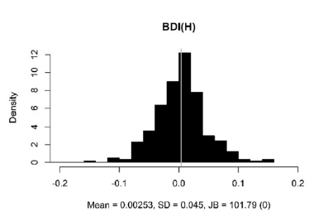
4. Testing the Approach
Modeled using QGIS and R software
Estimation matches observation
Matches more established methods
Histogram looks good
Can take top and bottom 5%

Slide 10
5. Presenting Findings
Answering questions for 25 large U.S. cities with clear borders:
Does neighborhood diversity change sharply at city/suburban borders? Yes, in some places (but not others) AND it can go either way (diverse city, diverse suburbs)
In which metro areas does this happen most? Atlanta is one example; depends on the city
Which specific suburbs have the biggest disparities? Wauwatosa and Warren; list includes Cicero and some others around Chicago
What might be the causes of this? Mostly race and income

Slide 11
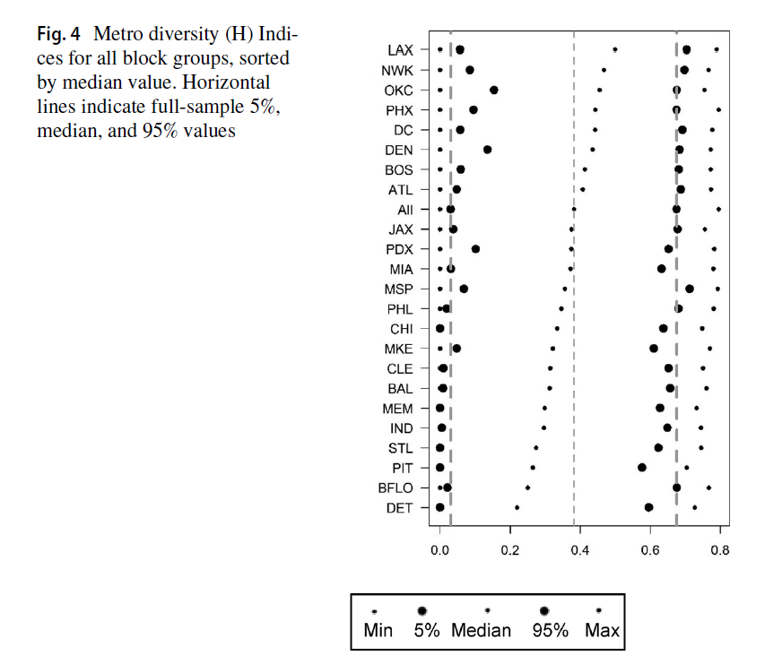
Diversity in Metropolitan Areas
Most diverse metros (25 total)
Chicago toward the middle
“Rust Belt” pattern toward the bottom

Slide 12
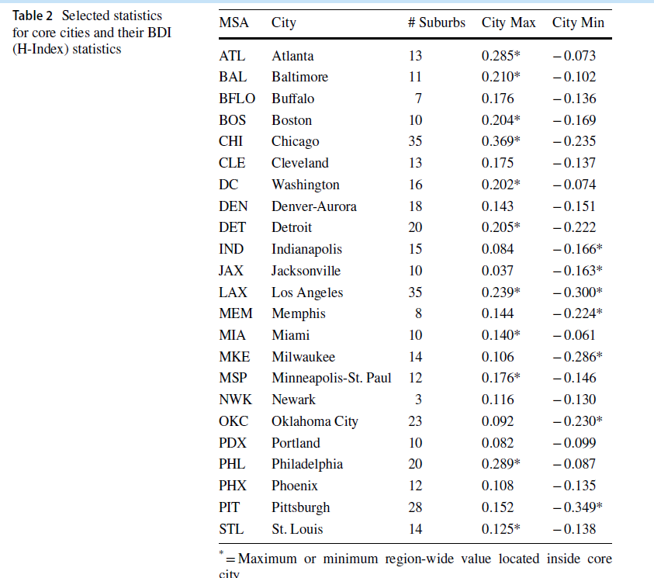
Neighborhood/City Diversity
Looks at largest and smallest values within cities
Chicago has a high value in the city (indicating a diverse suburb).
→ Compare to Boston and Cleveland, for example
Same for Atlanta, Philadelphia, and others

Slide 13
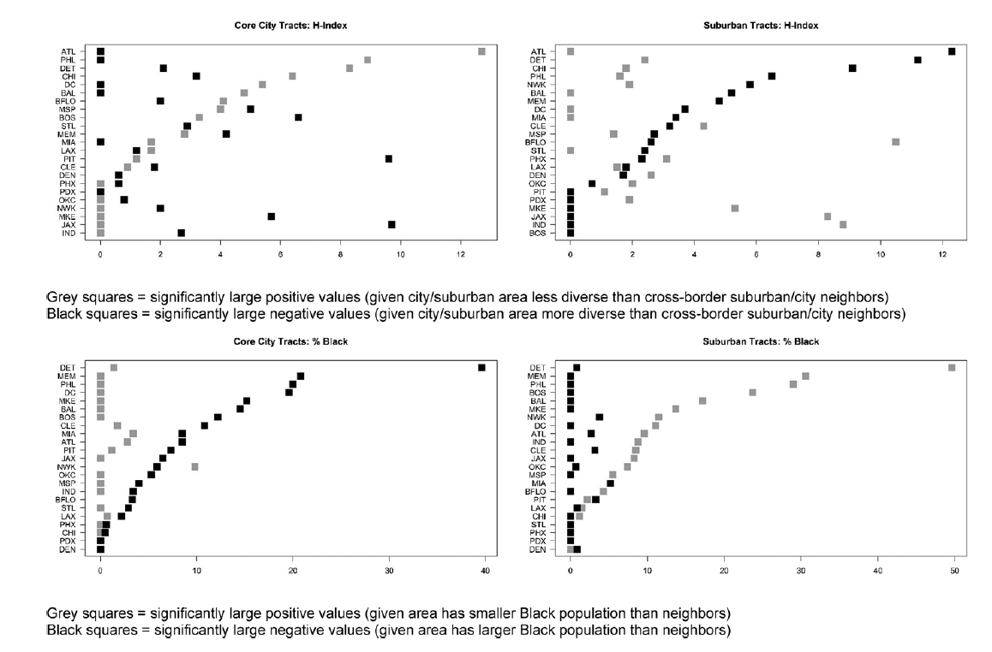
Visualizing City/Suburban Diversity
Atlanta, Detroit, Philadelphia, Chicago:
Lots of large positive city values
large negative suburban values
Suburbs more diverse
Portland, Milwaukee, Jacksonville, Indianapolis:
Fewer of each
City more diverse

Slide 14
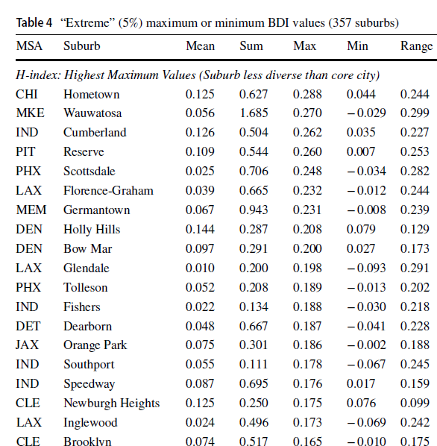
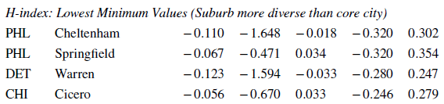
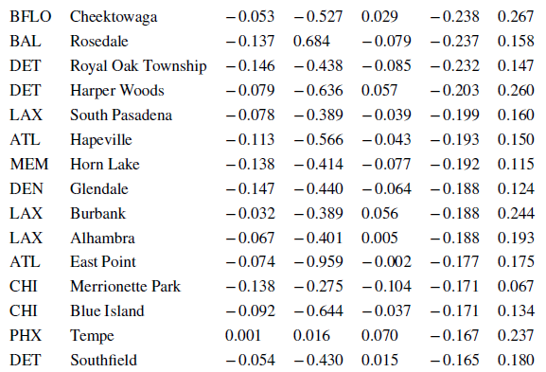
Identifying Specific Suburbs

Slide 15
Uncovering the Causes
Key variables: Neighborhood Income
Ethnic makeup (city and suburb)
Diversity levels
Control variables:
Length of border
Relative size of core city
Population density
Regression analysis (OLS w/standard errors clustered by MSA)

Slide 16
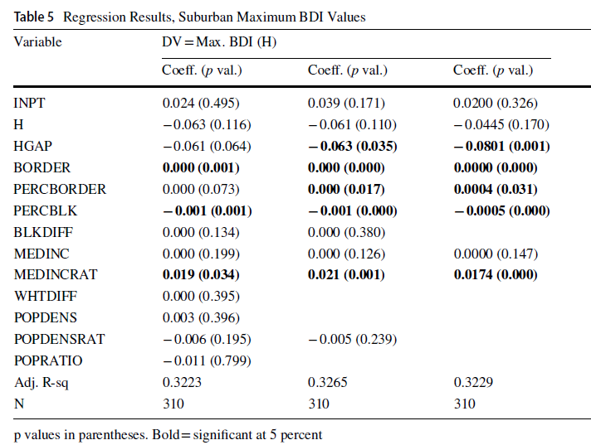
Uncovering the Causes
Testing 310 suburbs
Regression analysis
(successively drop insignificant variables)
Significant determinants:
Suburb-city diversity gap (-)
% Black population in suburb (-)
Ratio of suburb/city median income (+)
→ Richer, less diverse suburbs = bigger gaps
Significant controls :
Length of border (and % of total) (+)
Not significant:
Suburban diversity (overall)
Median income of suburb
Differences in suburb/city ethnic composition, total population, or population density

Slide 17
Possible Explanations
Restrictive covenants
School policy
Land values
Northern vs. Southern cities

Slide 18
6. Know Your Limitations
What about borders that aren’t straight lines?
What about smaller cities?
More refined methods
Are physical borders (parking lots, train tracks) important? And are they related (in either direction: physical ←→socioeconomic)
More literature
Other approaches (including non-quantitative)

Slide 19
Conclusion: Crossing borders
Between cities: Does seem to disrupt diversity patterns
Between disciplines: Formulating and answering questions Following the research process
Allocating resources equitably, implementing planning appropriately, and breaking down barriers will help achieve a more just society

Slide 20
Questions?
Thank you!

